Slide 1


Teaching Bible in the
Public Schools of
America
Bible Class @ NJHS
Hello!
By
Patsy A. Spence
B.S.L. Holmes Bible College
B.S.Ed. Barton College
NBCT

Slide 2
Define the question:
To what extent and in what ways can the Bible be taught in the public schools of America without infringing on the separation of church and state?

Slide 3
Bible can be taught in the public schools of America in the following ways...
In the High School Setting as an…
  Elective Course in…
    History
    Literature

Slide 4
Teaching Strategies
  Geography of Holy Land
    Past & Present
    Archaeological Finds
  Multimedia
    Videos
    Computer Graphics
    Web Sites
  Oral Presentations
    Individual
    Cooperative Group Presentations
    Debates
  Biographical Sketches
  Cultural Studies
    Ethnic Groups
    Religions
    Foods
    Governments
Bible as a History
  Lecture
  Reading
    Individual
    Group
  Writing
    Notes
    Outlines
    Research
  Art
    Maps
    Time Lines
    Travel Brochures

Slide 5
Teaching Strategies
Bible as a Literature
  Lectures
  Reading
    Personal Reading
    Reading Circles
  Writing
    Outlines
    Research
    Children’s Books
  Art
    Association Cards
    Group posters
    People Portraits
  Poetry
    Poems
      Narrative
      Prose
      Rhyme
    Creative Designs
    Illustrative Bookmarks
  Multimedia
    Videos
    Computer Graphics
    Web Sites
  Oral Presentations
  Traditional Tests

Slide 6
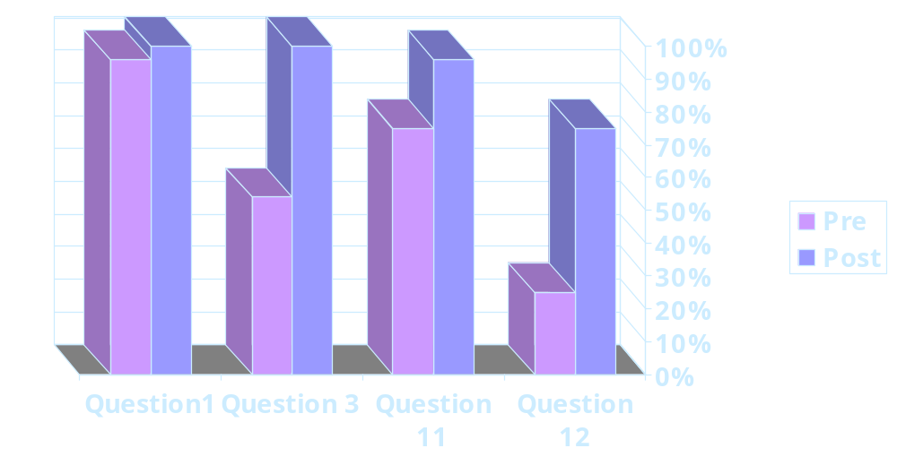

Pre & Post Bible Knowledge

Slide 7


Parent Survey
In a poll of 24 parents, 96% approved the teaching of Bible in public schools and only 4% were opposed.

Slide 8

Teaching Bible without infringing on the separation of church and state...
State Board of Education
Approval
Parent Approval
Supreme Court Case Rulings
Local School Board
Approval
Student Elective

Slide 9
A Few Ways to Teach Bible In the Public Schools of America...
    Lectures ->>> Reading
    Writing ->>> Research
    Art ->>> Technology
    ->>> Oral Presentations

Slide 10

See handouts for pictures.
Thank you!

Slide 11
In Conclusion...
Bible can be taught in the public schools of America without infringing on the separation of church and state, when taught from the standpoint of its historical and literary significance in the history of mankind.
Anno Domini 2002

